Slide 1
GRADE 7 ACCELERATED · UNIT 4 · LESSON 1
Adding and Subtracting in Scientific Notation
MA.8.NSO.1.5
I can add and subtract two numbers written in scientific notation, and write the answer in scientific notation.
Last unit you learned to write numbers in scientific notation.
Today you put two of them together — and the powers of ten have to match first.
Grade 7 Accelerated · Unit 4 · Lesson 1 — Adding and Subtracting in Scientific Notation
1

Slide 2


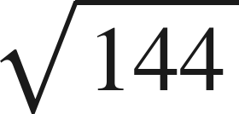

Warm-Up
On your own. Four minutes. No notes.
1. Write 0.00062 in scientific notation.
2. How many times larger is
than
?
3. Find the value:
4. Find the sum:
Grade 7 Accelerated · Unit 4 · Lesson 1 — Adding and Subtracting in Scientific Notation
2

Slide 3
Warm-Up
Answers.
1. Write 0.00062 in scientific notation.
6.2 × 10⁻⁴
2. How many times larger is
than
?
4,000
3. Find the value:
12
4. Find the sum:
1.69
Grade 7 Accelerated · Unit 4 · Lesson 1 — Adding and Subtracting in Scientific Notation
3

Slide 4
Notes
Copy the table.
I. A power of ten is a place value
10³ | 10⁴ | 10⁵ | 10⁶
thousands | ten thousands | hundred thousands | millions
Two numbers can be added only when they carry the same power of ten.
Grade 7 Accelerated · Unit 4 · Lesson 1 — Adding and Subtracting in Scientific Notation
4

Slide 5
Notes
II. Same power: add or subtract the coefficients
Add or subtract the coefficients. The power of ten does not change.
Then check the coefficient: if it is not between 1 and 10, the answer is not finished.
Grade 7 Accelerated · Unit 4 · Lesson 1 — Adding and Subtracting in Scientific Notation
5

Slide 6
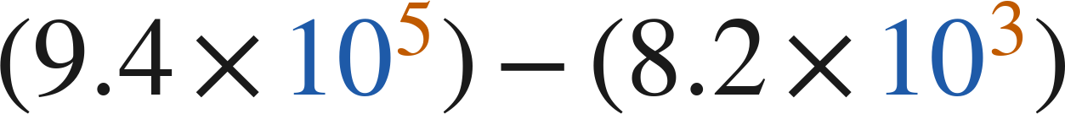
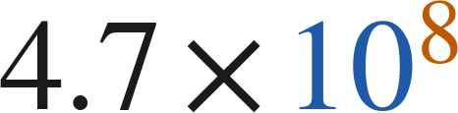
Notes
III. Different powers: rewrite one of them first
, never
Rewrite one number so both carry the same power of ten, then add or subtract the coefficients.
Exponent up one, decimal point one place left. The value does not move.
Grade 7 Accelerated · Unit 4 · Lesson 1 — Adding and Subtracting in Scientific Notation
6

Slide 7
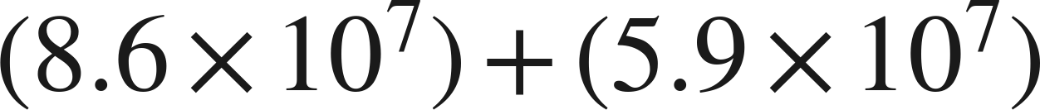
Example 1
Same power, and the answer is not finished.
Add. Write the answer in scientific notation.
Grade 7 Accelerated · Unit 4 · Lesson 1 — Adding and Subtracting in Scientific Notation
7

Slide 8
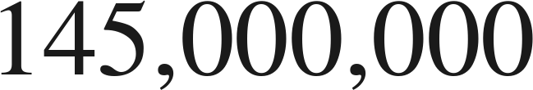
Example 1
Worked.
same power: add the coefficients
14.5 is not less than 10: point one place left, exponent up one
check in standard form
Answer: 1.45 × 10⁸
Grade 7 Accelerated · Unit 4 · Lesson 1 — Adding and Subtracting in Scientific Notation
8

Slide 9
Your Turn
Same steps, your numbers. Boards up when done.
Grade 7 Accelerated · Unit 4 · Lesson 1 — Adding and Subtracting in Scientific Notation
9

Slide 10
Your Turn
Answer.
12.3 × 10⁻³, then repair
Answer: 1.23 × 10⁻²
Grade 7 Accelerated · Unit 4 · Lesson 1 — Adding and Subtracting in Scientific Notation
10

Slide 11
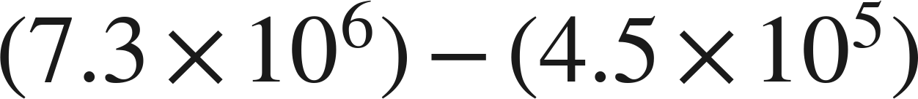
Example 2
Different powers, and a subtraction.
Subtract. Write the answer in scientific notation.
Grade 7 Accelerated · Unit 4 · Lesson 1 — Adding and Subtracting in Scientific Notation
11

Slide 12
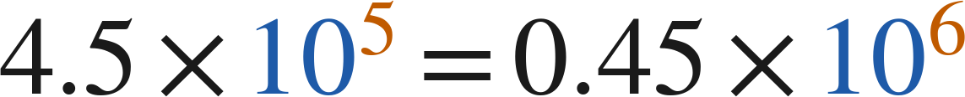
Example 2
Worked.
rewrite over 10⁶
same power: subtract the coefficients
check in standard form
Answer: 6.85 × 10⁶
Grade 7 Accelerated · Unit 4 · Lesson 1 — Adding and Subtracting in Scientific Notation
12

Slide 13
Your Turn
Same steps, your numbers. Boards up when done.
Grade 7 Accelerated · Unit 4 · Lesson 1 — Adding and Subtracting in Scientific Notation
13

Slide 14
Your Turn
Answer.
0.09 × 10⁻⁴ comes off 5.6 × 10⁻⁴
Answer: 5.51 × 10⁻⁴
Grade 7 Accelerated · Unit 4 · Lesson 1 — Adding and Subtracting in Scientific Notation
14

Slide 15
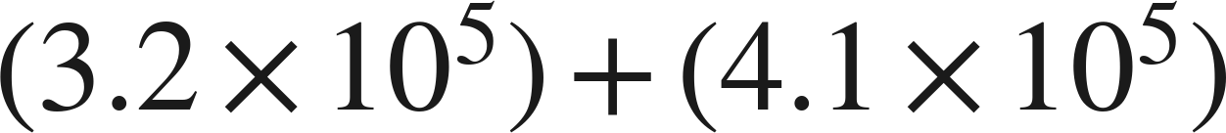
Whiteboards · Question 1 of 9
Boards up on three.
Answer it.
Same power.
Grade 7 Accelerated · Unit 4 · Lesson 1 — Adding and Subtracting in Scientific Notation
15

Slide 16
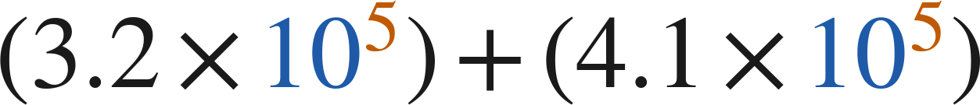
Whiteboards · Question 1 of 9
Answer.
add the coefficients
Answer: 7.3 × 10⁵
Grade 7 Accelerated · Unit 4 · Lesson 1 — Adding and Subtracting in Scientific Notation
16

Slide 17
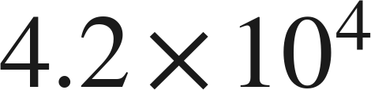
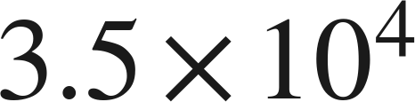
Whiteboards · Question 2 of 9
Boards up on three.
A stadium sold
tickets on Friday
and
on Saturday. Each ticket cost 38 dollars.
How many tickets were sold on the two days?
Answer it.
Same power.
Grade 7 Accelerated · Unit 4 · Lesson 1 — Adding and Subtracting in Scientific Notation
17

Slide 18
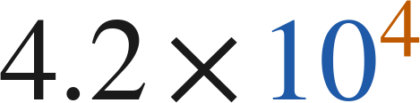
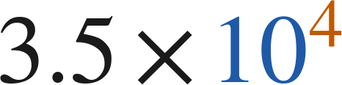
Whiteboards · Question 2 of 9
Answer.
A stadium sold
tickets on Friday
and
on Saturday. Each ticket cost 38 dollars.
How many tickets were sold on the two days?
4.2 + 3.5
Answer: 7.7 × 10⁴
Grade 7 Accelerated · Unit 4 · Lesson 1 — Adding and Subtracting in Scientific Notation
18

Slide 19
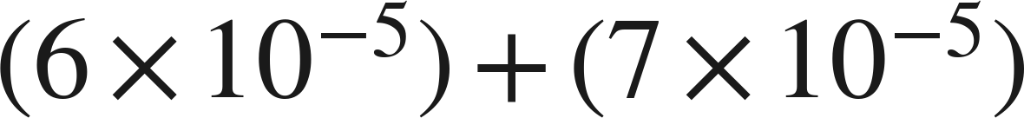
Whiteboards · Question 3 of 9
Boards up on three.
Answer it.
Finish the answer.
Grade 7 Accelerated · Unit 4 · Lesson 1 — Adding and Subtracting in Scientific Notation
19

Slide 20
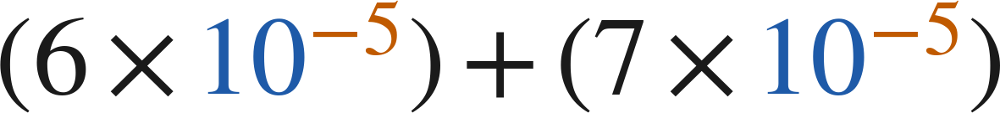
Whiteboards · Question 3 of 9
Answer.
13 × 10⁻⁵ is not finished
Answer: 1.3 × 10⁻⁴
Grade 7 Accelerated · Unit 4 · Lesson 1 — Adding and Subtracting in Scientific Notation
20

Slide 21
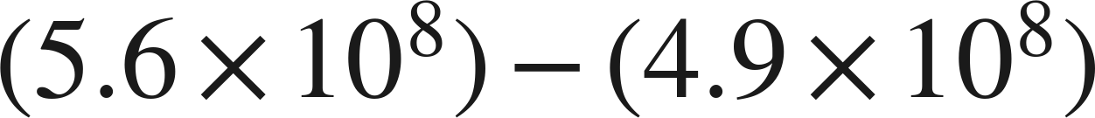
Whiteboards · Question 4 of 9
Boards up on three.
Answer it.
Finish the answer.
Grade 7 Accelerated · Unit 4 · Lesson 1 — Adding and Subtracting in Scientific Notation
21

Slide 22
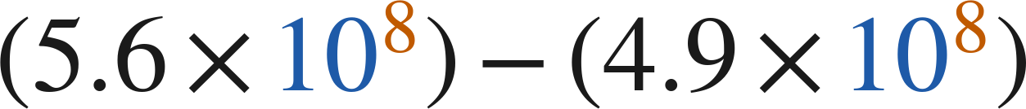
Whiteboards · Question 4 of 9
Answer.
0.7 × 10⁸ is not finished either
Answer: 7 × 10⁷
Grade 7 Accelerated · Unit 4 · Lesson 1 — Adding and Subtracting in Scientific Notation
22

Slide 23
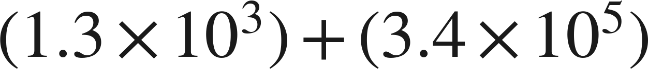
Whiteboards · Question 5 of 9
Boards up on three.
Which is the sum?
A. 4.7 × 10⁵
B. 4.7 × 10⁸
C. 3.413 × 10⁵
D. 3.53 × 10⁵
Answer it.
Grade 7 Accelerated · Unit 4 · Lesson 1 — Adding and Subtracting in Scientific Notation
23

Slide 24
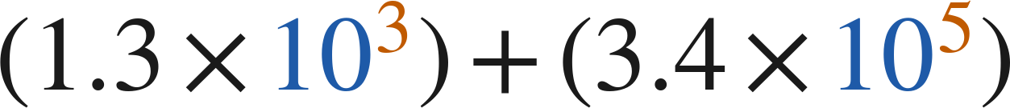
Whiteboards · Question 5 of 9
Answer.
Which is the sum?
A. 4.7 × 10⁵
B. 4.7 × 10⁸
C. 3.413 × 10⁵
D. 3.53 × 10⁵
Answer: C — 3.413 × 10⁵
Grade 7 Accelerated · Unit 4 · Lesson 1 — Adding and Subtracting in Scientific Notation
24

Slide 25
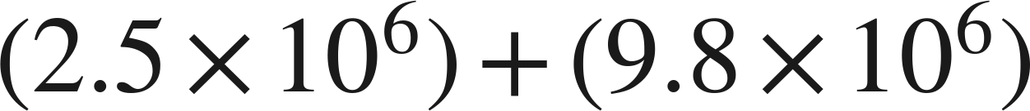
Whiteboards · Question 6 of 9
Boards up on three.
Which is the sum, written in scientific notation?
A. 12.3 × 10⁶
B. 12.3 × 10¹²
C. 1.23 × 10⁶
D. 1.23 × 10⁷
Answer it.
Grade 7 Accelerated · Unit 4 · Lesson 1 — Adding and Subtracting in Scientific Notation
25

Slide 26
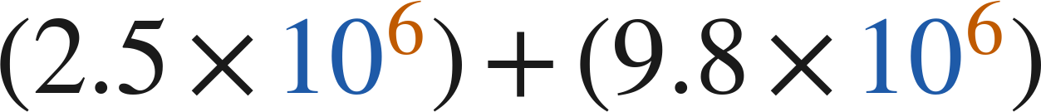
Whiteboards · Question 6 of 9
Answer.
Which is the sum, written in scientific notation?
A. 12.3 × 10⁶
B. 12.3 × 10¹²
C. 1.23 × 10⁶
D. 1.23 × 10⁷
Answer: D — 1.23 × 10⁷
Grade 7 Accelerated · Unit 4 · Lesson 1 — Adding and Subtracting in Scientific Notation
26

Slide 27
Whiteboards · Question 7 of 9
Boards up on three.
Answer it.
Rewrite one of them first.
Grade 7 Accelerated · Unit 4 · Lesson 1 — Adding and Subtracting in Scientific Notation
27

Slide 28
Whiteboards · Question 7 of 9
Answer.
6.4 × 10⁻³ = 0.64 × 10⁻²
Answer: 7.16 × 10⁻²
Grade 7 Accelerated · Unit 4 · Lesson 1 — Adding and Subtracting in Scientific Notation
28

Slide 29

Whiteboards · Question 8 of 9
Boards up on three.
What is the value of
?
Answer it.
Rewrite the answer over 10⁶ first.
Grade 7 Accelerated · Unit 4 · Lesson 1 — Adding and Subtracting in Scientific Notation
29

Slide 30
Whiteboards · Question 8 of 9
Answer.
What is the value of
?
1.02 × 10⁷ = 10.2 × 10⁶
Answer: n = 5.7
Grade 7 Accelerated · Unit 4 · Lesson 1 — Adding and Subtracting in Scientific Notation
30

Slide 31
Whiteboards · Question 9 of 9
Take your time. Boards up when you have written it.
Devon writes
.
Name the two mistakes he made, and give the correct sum.
Write your answer in sentences.
Two mistakes, then the sum.
Grade 7 Accelerated · Unit 4 · Lesson 1 — Adding and Subtracting in Scientific Notation
31

Slide 32
Whiteboards · Question 9 of 9
Answer.
Devon writes
.
Name the two mistakes he made, and give the correct sum.
one mistake in the coefficients, one in the exponents
Answer: 3.413 × 10⁵
Grade 7 Accelerated · Unit 4 · Lesson 1 — Adding and Subtracting in Scientific Notation
32

Slide 33
Independent Set
Six questions. On your own, in silence.
1.
Six questions. Work down the page.
2.
Show the step that does the work, not just the answer.
3.
Silence until the six minutes are up.
Grade 7 Accelerated · Unit 4 · Lesson 1 — Adding and Subtracting in Scientific Notation
33

Slide 34
IXL
Last five minutes.
1.
Open IXL and start today's skills.
2.
Work on paper where the question needs work. The answer box does not show it.
3.
Every skill listed is required, to a SmartScore of 67. Due at the start of the next class.
Today's skills — all required
Add and subtract numbers written in scientific notation — HUR
Grade 7 Accelerated · Unit 4 · Lesson 1 — Adding and Subtracting in Scientific Notation
34

